Slide 1
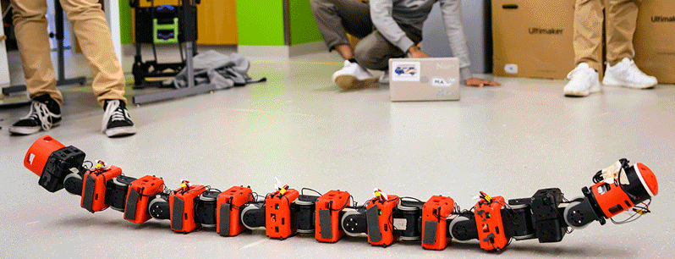

RTAB-Map Onboard COBRA
Team 12
Henry Noyes, Nishad Rajhans, Mayank Polagoni, Sai Kiran Athaluri

Slide 2

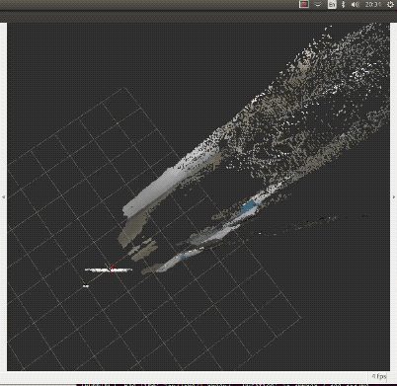
RTAB-Map Overview
RTAB Mapping
Real-Time Appearance-Based Mapping, or RTAB, is an effective technique for simultaneous localization and mapping (SLAM) in computer vision and robotics. It allows robots to localize themselves inside an environment and create a map of it.
The input data for RTAB MAP:
Cameras:
RGB Cameras: Standard color cameras for 2D feature extraction.
RGB-D Cameras: Cameras that provide both color and depth information (e.g., Intel RealSense, Microsoft Kinect).
Stereo Cameras: Two cameras providing stereo images for depth estimation (e.g., ZED cameras).
LiDAR: Point cloud data from LiDAR sensors can be used for precise 3D mapping and localization.
IMU: Inertial Measurement Unit (IMU) provides accelerometer and gyroscope data for motion estimation and odometry.

Slide 3
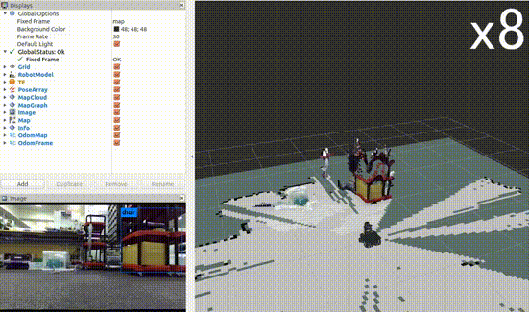
RTAB-Map Overview
Default feature description:
The Default feature description algorithm used for the RTAB slam algorithm is SIFT, (Scale-Invariant Feature Transform) as the default feature detector, which is generally a good balance between accuracy and performance.
Bag-of-Words (BoW) for Place Recognition
Not a feature detector, but a mechanism for comparing visual features.
Converts extracted features (e.g., ORB, SIFT, SURF) into visual words for efficient matching and loop closure detection.
Structure of Factor Graphs:
Nodes: Represent variables to be estimated (e.g., robot poses, landmark locations).
Factors: Represent constraints or relationships between variables.
Examples: Odometry measurements, loop closures, or sensor observations.
Edges: Connect nodes to factors, forming a bipartite graph.
Graph Optimization:
RTAB-Map uses solvers like g2o or Ceres Solver to minimize the errors in the graph.
This step aligns the map and corrects drift by adjusting poses based on odometry and loop closures.

Slide 4
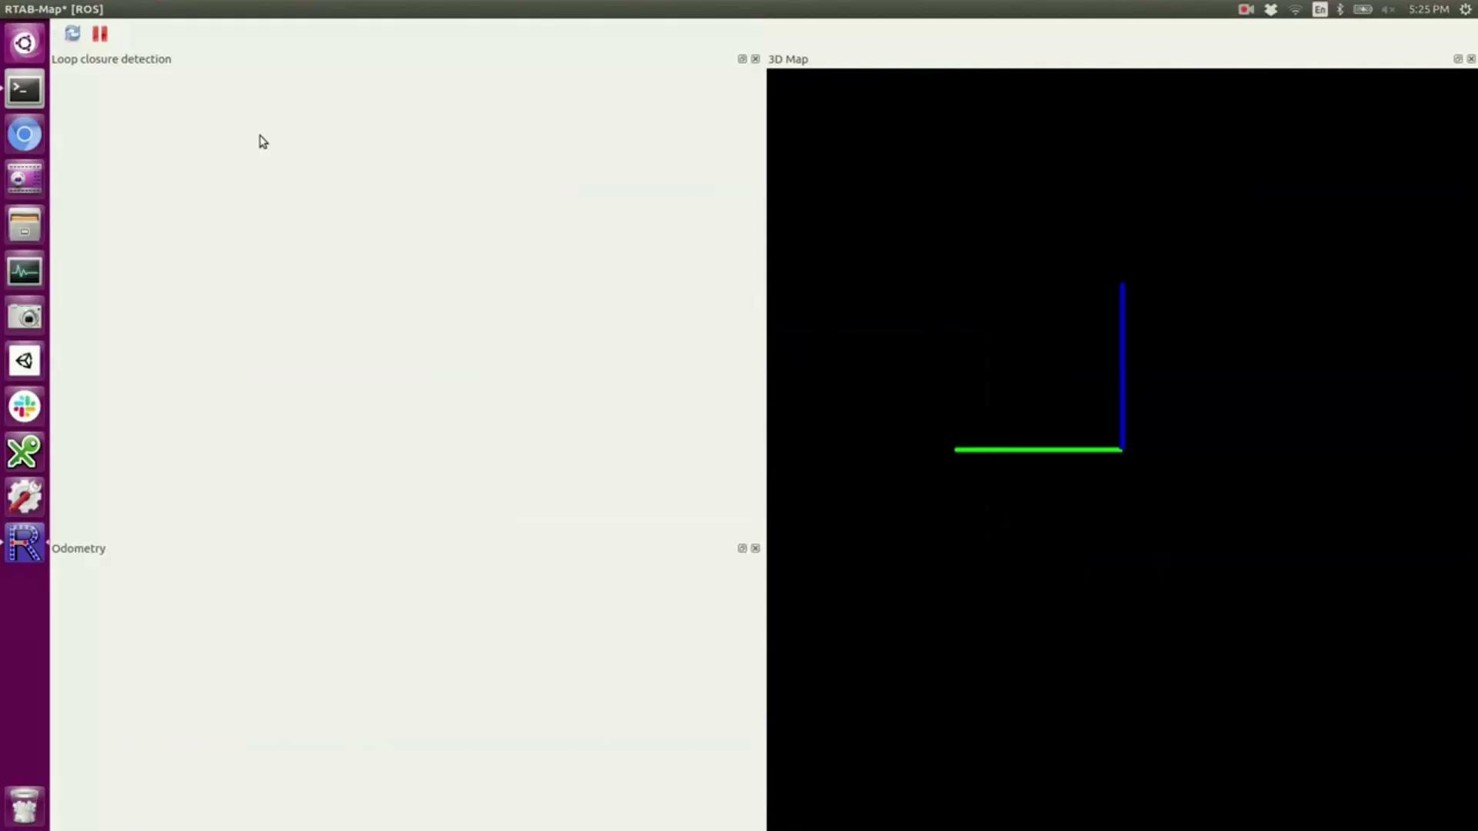
Description for the RTAB Mapping Dataset
RTAB-Map Overview
For this RTAB-Map sequence on freiburg1_xyz from the TUM dataset, the camera was pointed at a typical desk in an office environment. This sequence contains only translatory motions along the principal axes of the camera, while the orientation was kept (mostly) fixed.
ROS bag file (file size: approx. 0.42GB)
Ground-truth trajectory length: 7.112m
Avg. translational velocity: 0.244m/s
Avg. angular velocity: 8.920deg/s

Slide 5
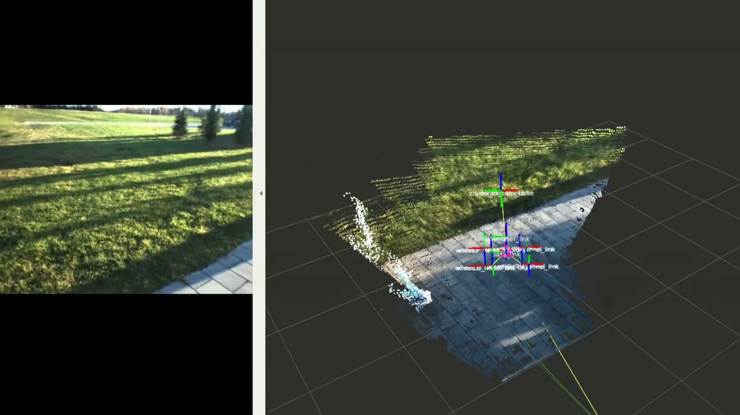
RTAB-Map Overview
This video highlights RTAB-Map's ability to map outdoor areas using stereo camera data in a robust and efficient way.

Slide 6
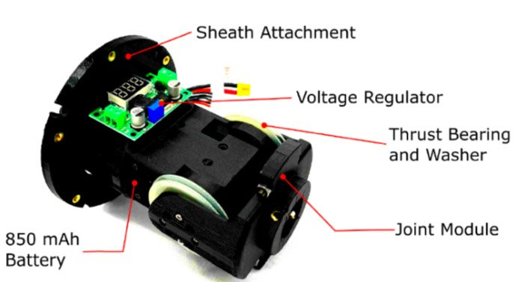
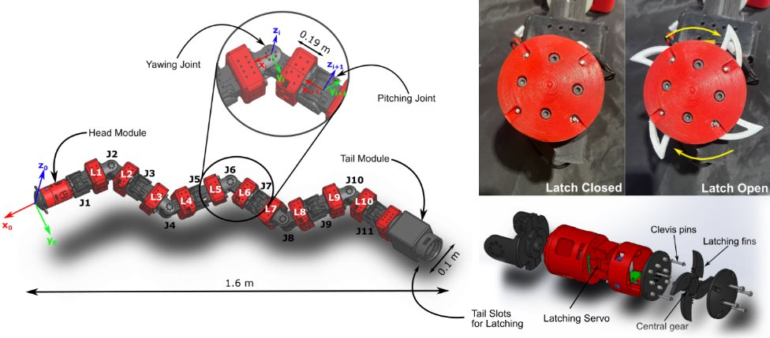
COBRA Hardware
11 Joint Modules
12V Dynamixel Servo
850mAh LiPo
Printed in PLA and Onyx (carbon fiber composite)
1.6 meters; 7kg
Notes:
Unique head and tail module
Multiple modes of locomotion (sidewinding, tumbling)
Majority of parts 3D printed

Slide 7
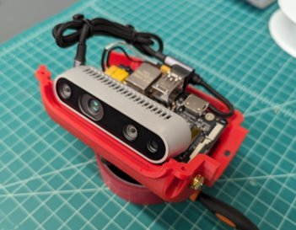
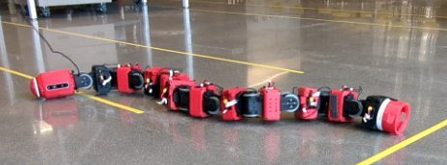
COBRA Hardware
Main board: Jetson Orin NX 8GB​
Camera: Intel RealSense D435i​
RGB 640x480 30Hz​
Depth 640x480 15Hz​
IMU 200Hz (fused)
Notes:
RealSense has 2 IR cameras, 1 RGB
Stereoscopic depth up to 3m
Input RGB-D + IMU to RTAB-Map

Slide 8
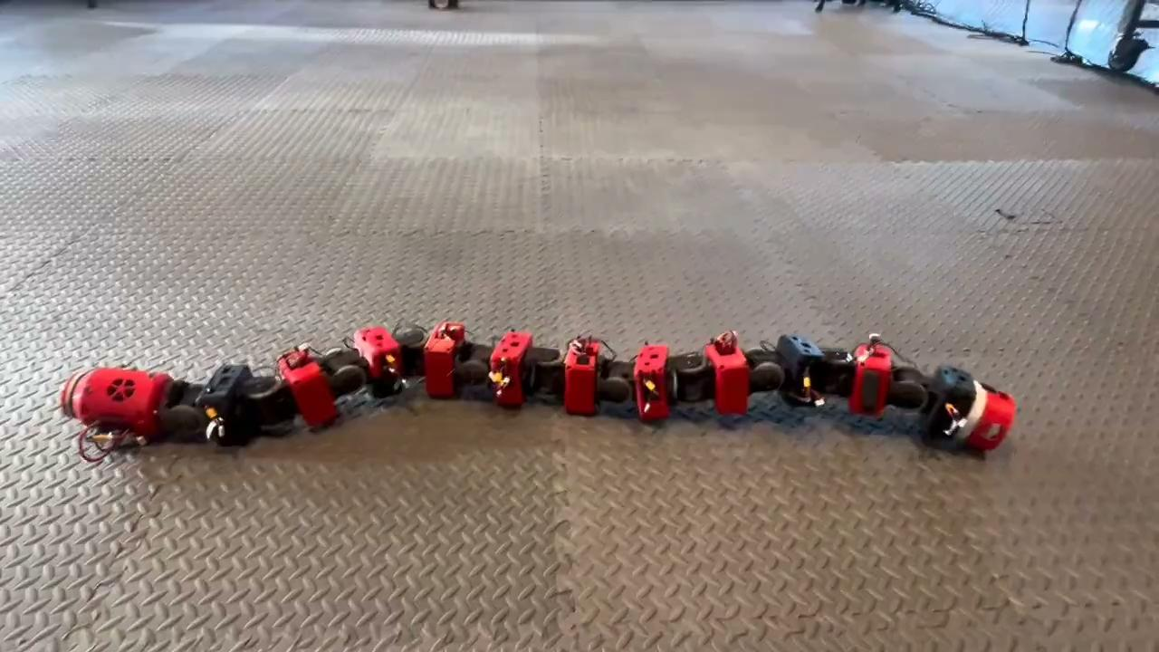
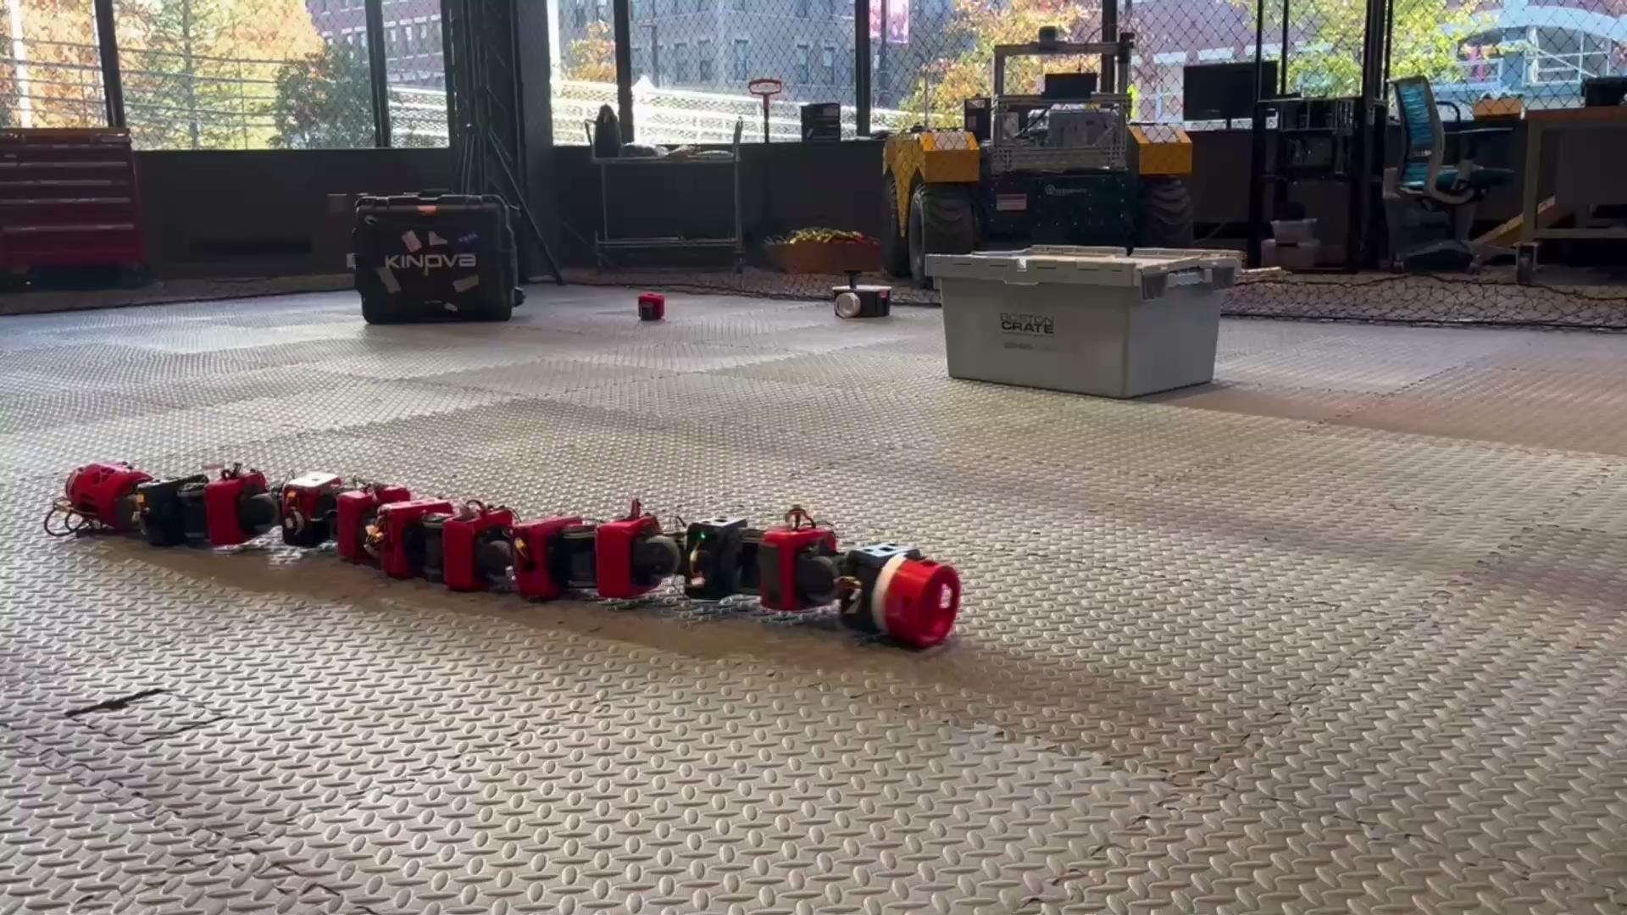
Data Collection
Collected data inside EXP Drone Cage
Tested with varying environments and gaits
Notes:
Performed slow sidewinding gait inside EXP drone cage
OptiTrack markers for ground truth pose
Tested with objects in environment, different speed gaits

Slide 9
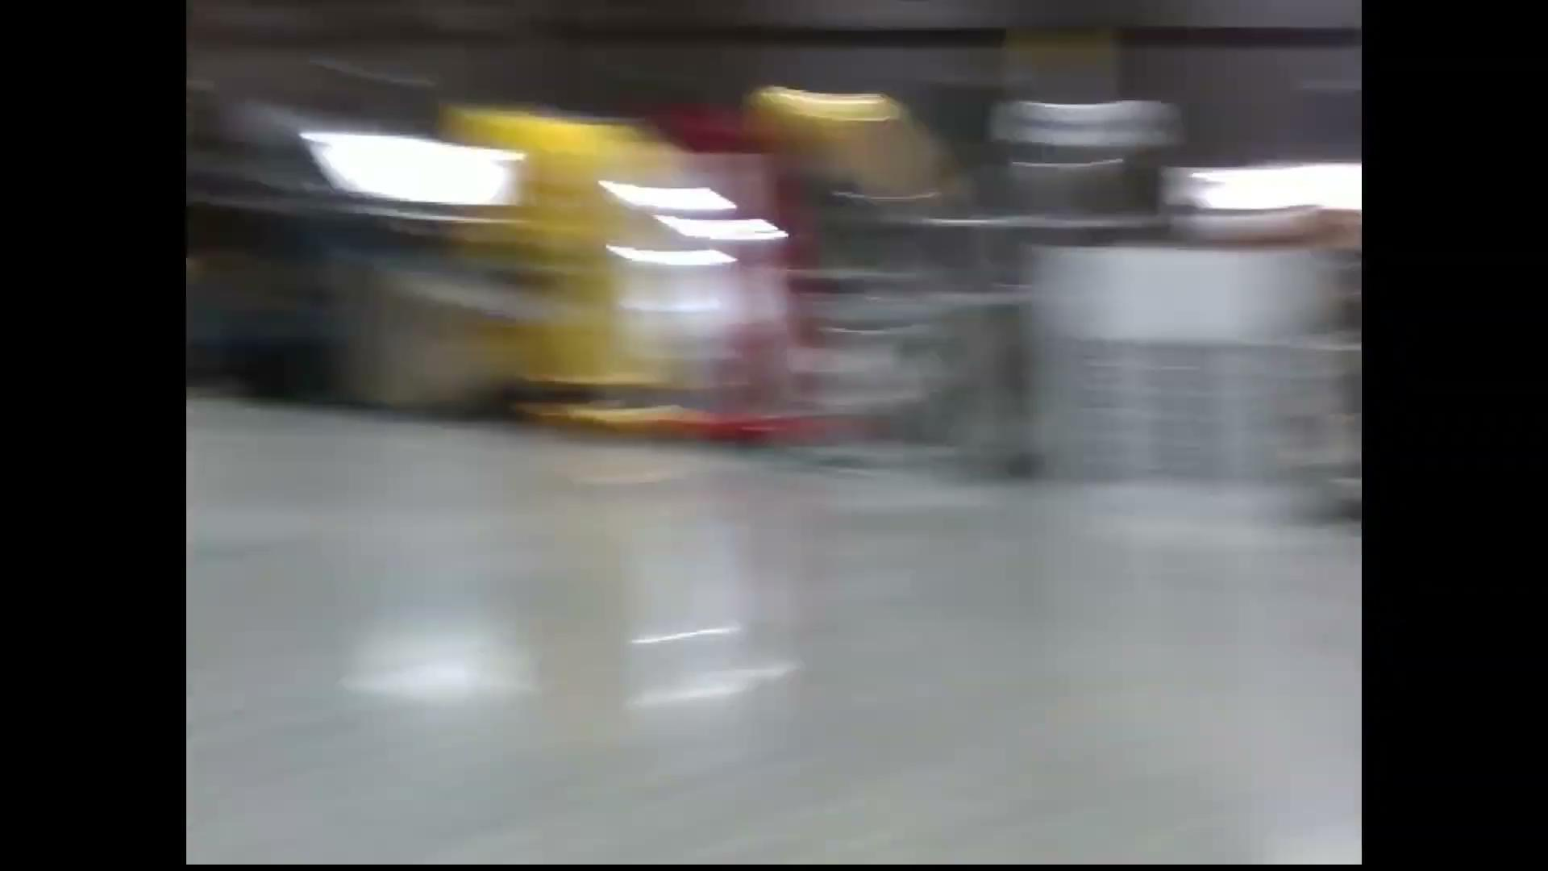
Data Collection
Fast sidewinding gait: difficult for SLAM algorithms due to choppy movement and motion blur
Notes:
Out-of-the-box RTAB fails with this motion
Future work: optimize SLAM algorithm to function during fast sidewinding

Slide 10
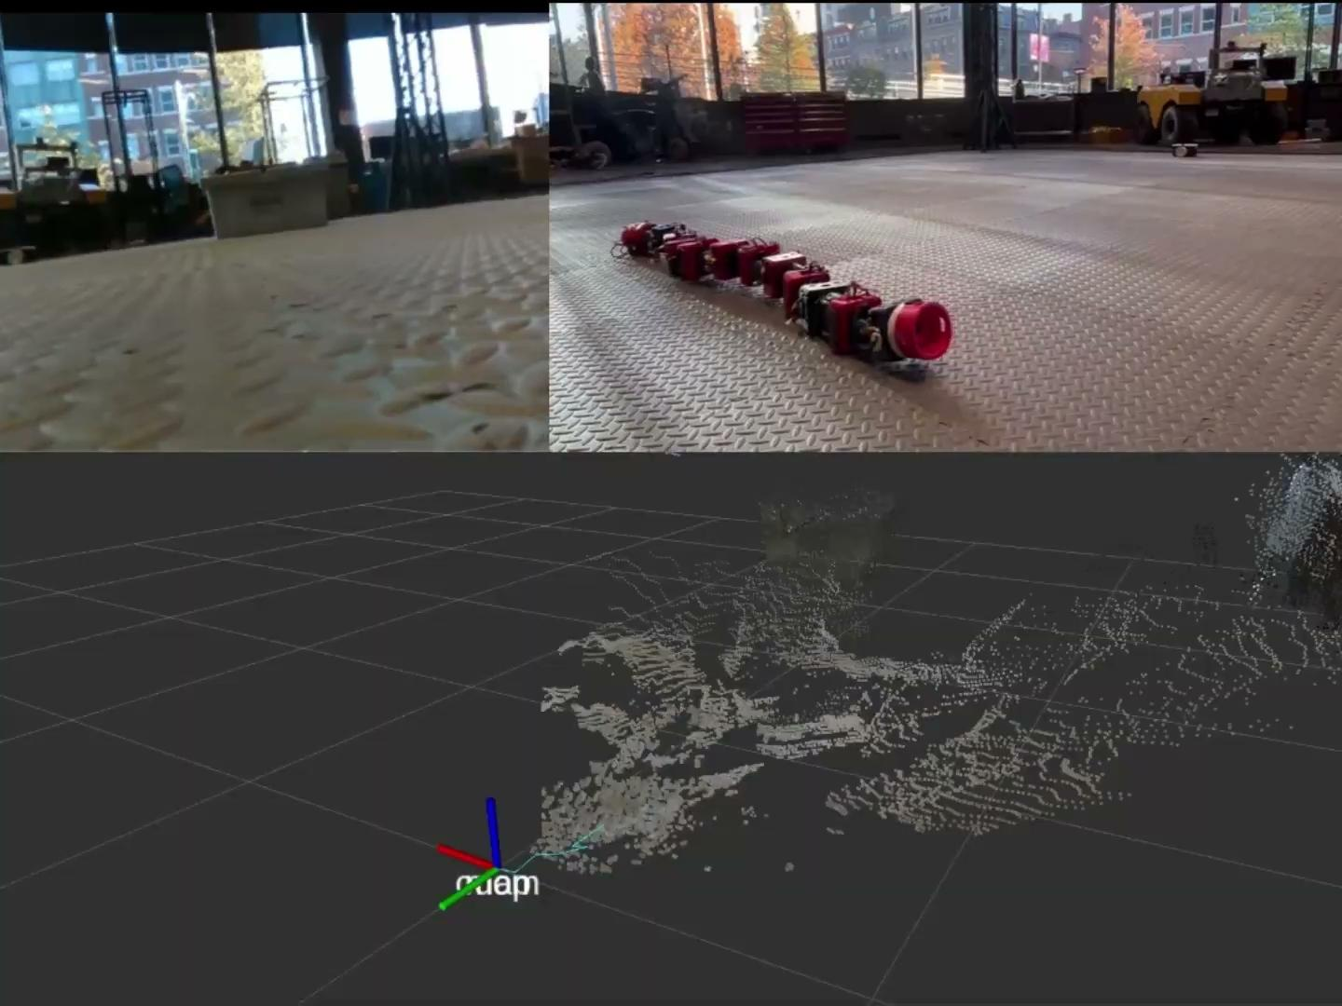
RTAB-Map Results
RTAB-Map output during slow sidewinding
RTAB able to maintain tracking through entire 2 minute sequence
Lack of objects in environment -> sparse point cloud
Notes:
RTAB able to maintain tracking through entire 2 minute sequence
RVIZ path shown is globally optimized path (1Hz) not local odom (6-7Hz)
Pointcloud could benefit from closer objects

Slide 11
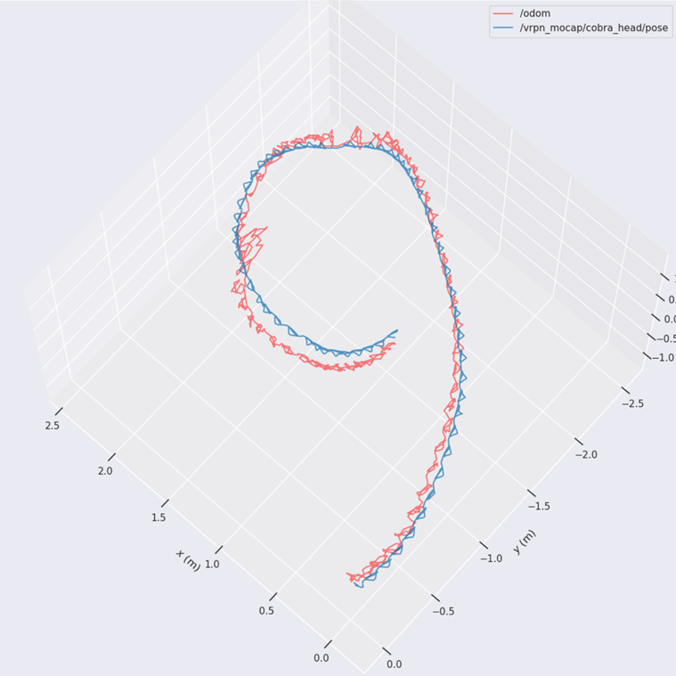
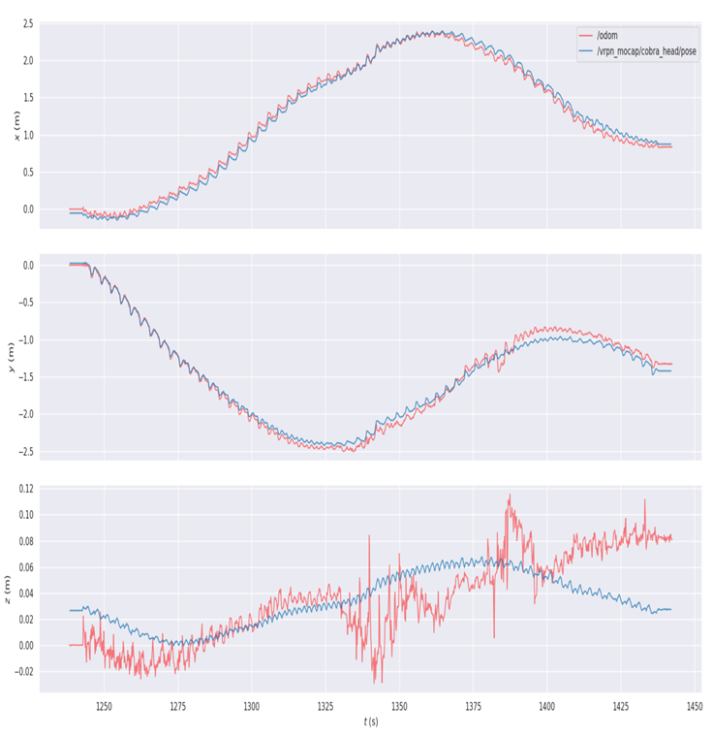
RTAB-Map Results
Benchmarking RTAB-Map odometry vs OptiTrack ground truth (Evo)
Notes:
Used Evo python package to compute odometry metrics
Hard-aligned trajectories
Spots where RTAB slightly loses track, but recovers

Slide 12
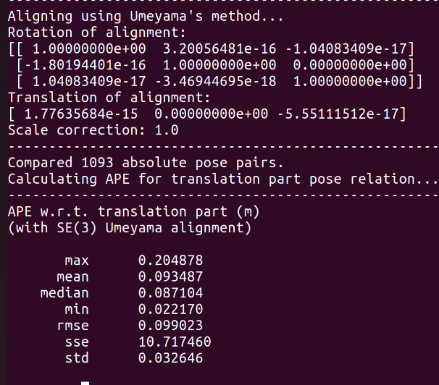
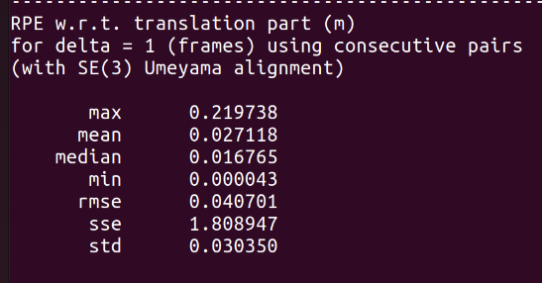
RTAB-Map Results
Benchmarking RTAB-Map odometry vs OptiTrack ground truth (Evo)
Notes:
Computed metrics from Evo comparison
Within 10cm APE, 4cm RPE
Future work: benchmark map quality with lidar, test in confined spaces

Slide 13
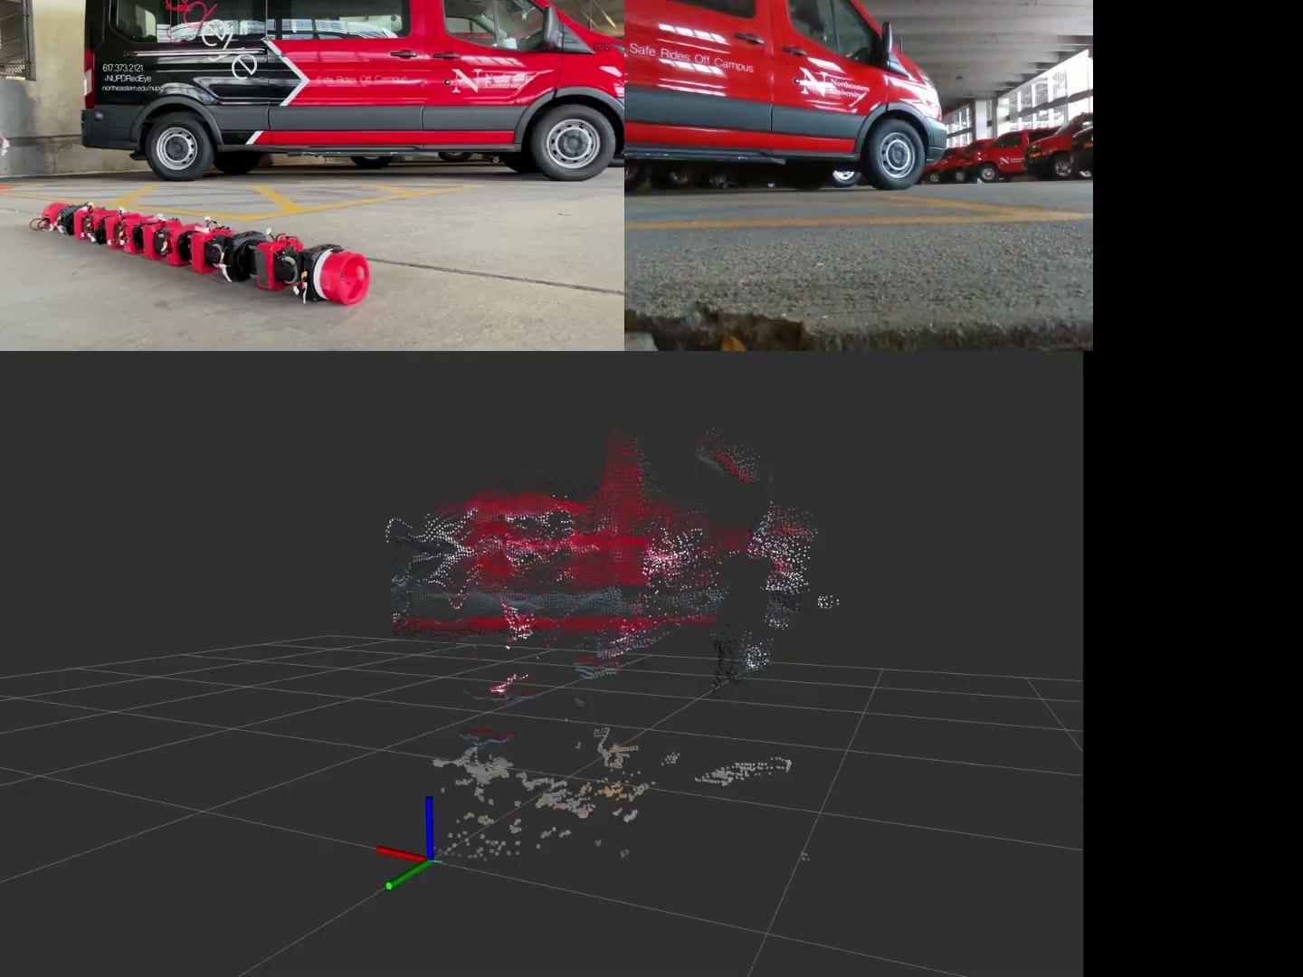
Future Work
Benchmark RTAB-Map mapping using external LiDAR
Further evaluate strengths/limitations of RTAB with different gaits, environments, etc.
Implement techniques to improve performance during faster sidewinding

Slide 14
RTAB-Map Results
Thank You! Questions?

